Slide 1
Automated Measurements Using OpenWPM Tool
@inproceedings{englehardt2016census,
author = "Steven Englehardt and Arvind Narayanan",
title = "{Online tracking: A 1-million-site measurement and analysis}",
booktitle = {Proceedings of ACM CCS 2016},
year = "2016",
}

Slide 2
In this session: Setup and website data crawling
How to install / launch OpenWPM
What options / settings available
What crawling mechanisms are deployed
How to build synthetic profiles (Stateful)
What data can be collected
Hands On!
Notes:
Use OpenWPM go to some website and crawl. Give “taste” of what it feels like.

Slide 3
What is OpenWPM
(Open-source web privacy measurement tool)
Privacy measurements framework
Selenium
Python
Firefox
Stateless(ful)
Scalable (Thousands to Millions websites)
Easy to set-up!
Openly available at: https://github.com/mozilla/OpenWPM

Slide 4
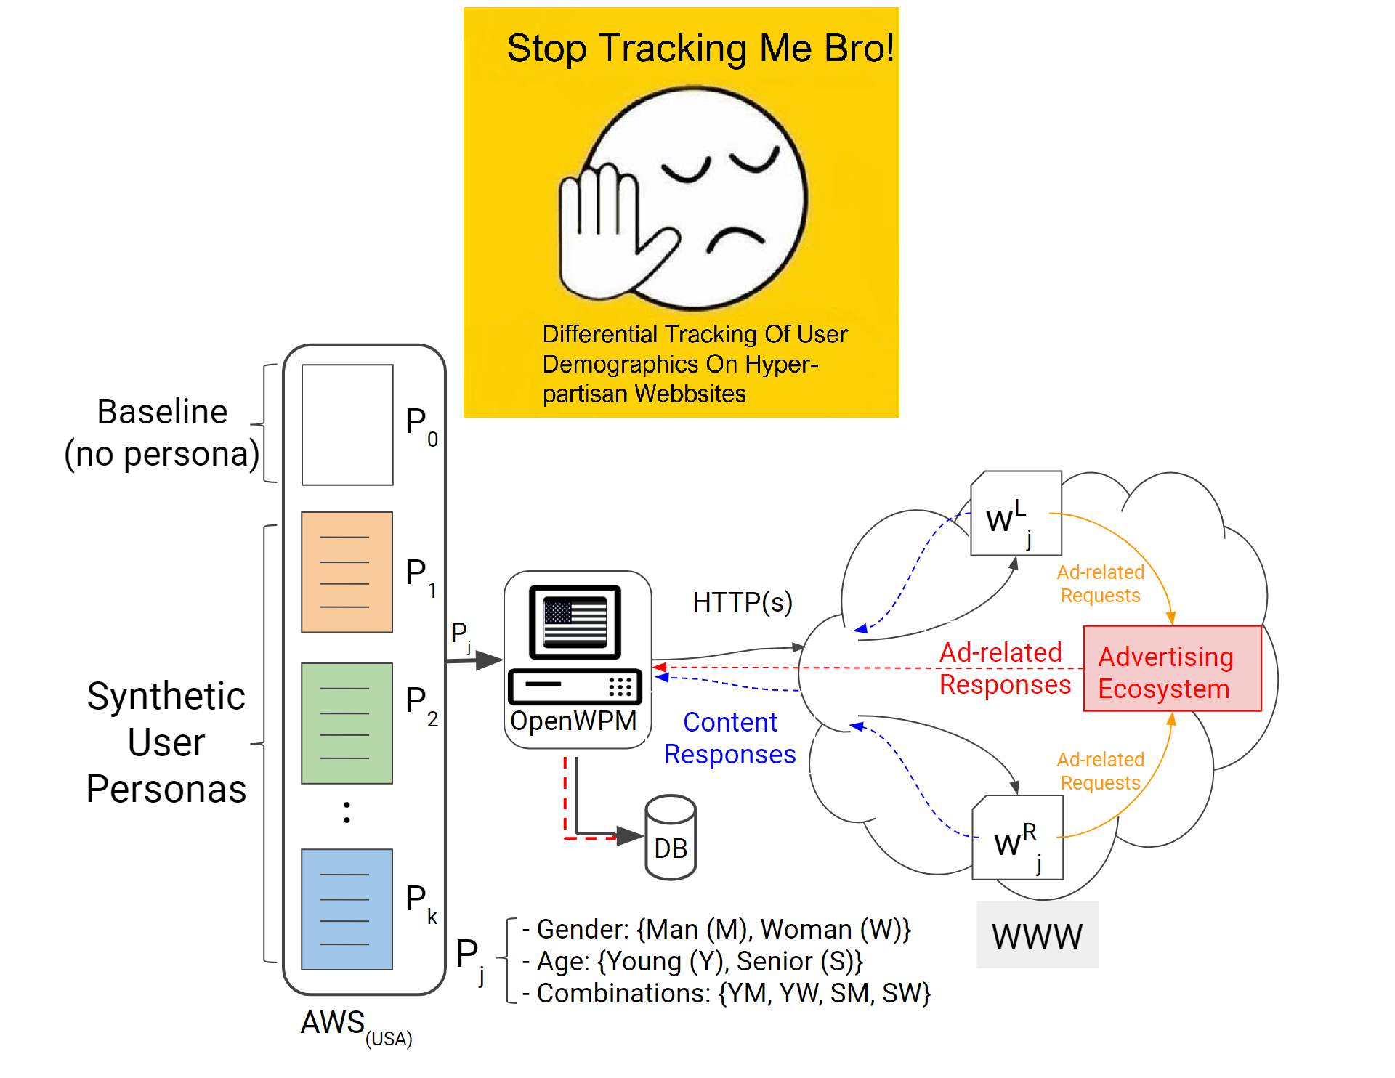

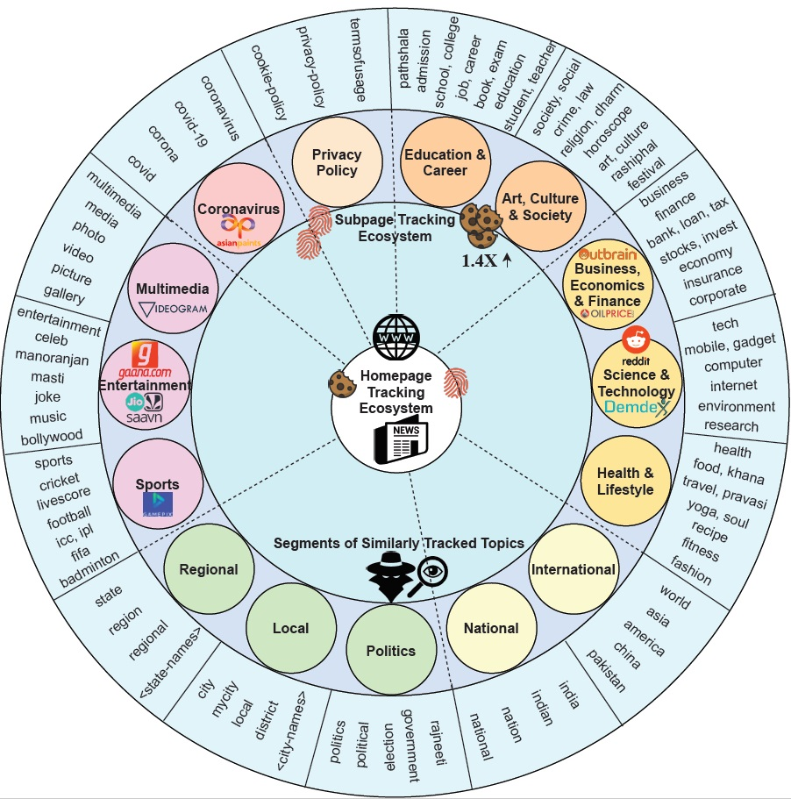
ACM Web-Science 2021
http://tiny.cc/india-topic
The Web Conference 2020
http://tiny.cc/partisan-tracking
AAAI ICWSM 2021
http://tiny.cc/india-tracking

Slide 5
Setup: As available on Github
Navigate to : https://github.com/mozilla/OpenWPM
Steps also available on: http://tiny.cc/openwpm-install
Anaconda (In house environment)
Docker (container for running across platforms using local paths)
Container: http://tiny.cc/openwpm-docker

Slide 6
See you in the OPENWPM playground!
INSTALLATION
Navigate to : https://github.com/mozilla/OpenWPM
Steps also available on: http://tiny.cc/openwpm-install
Anaconda (In house environment)
Docker (container for running across platforms using local paths)
Container: http://tiny.cc/openwpm-docker

Slide 7
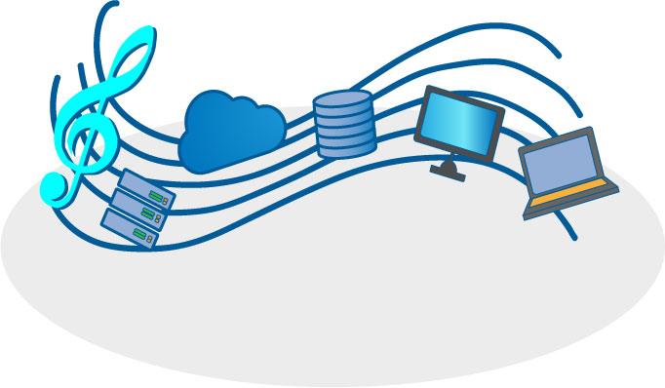
What options / settings available?
Parallel orchestration
Plug-ins for ad-blocking
Headless browsing
Snapshots
Scroll pages
Stateful (less)
Much more!
$vim demo.py

Slide 8
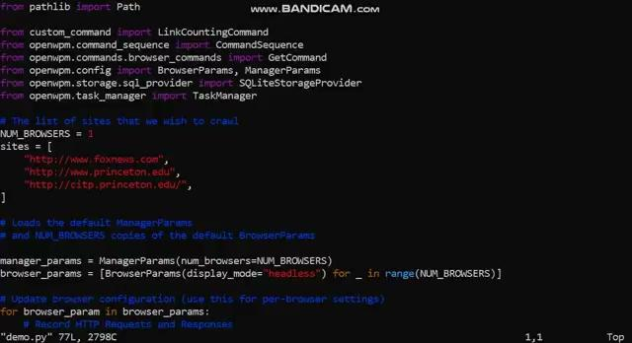
Options in /openWPM/demo.py

Slide 9
What crawling mechanisms are deployed?
Crawling website traffic.
First-party cookies.
Third-party cookies
Canvas fingerprinting, evercookies and cookie syncing.
AAAI ICWSM, Under the Spotlight: Web Tracking in Indian Partisan News Websites (2021) tiny.cc/india-tracking/
The Web Conference (WWW), Stop tracking me Bro! Differential Tracking of User Demographics on Hyper-Partisan Websites (2020) http://tiny.cc/partisan-tracking

Slide 10
In this tutorial activity
Case study 1: Tracking across countries
USA versus India news websites (Stateless)
Case study 2: Building artificial user personas
Women versus Men (Stateful, “default”)
$vim demo.py → <change websites names>

Slide 11

Case study 1: Changing websites list
http://www.foxnews.com
http://ndtv.com
…

Slide 12
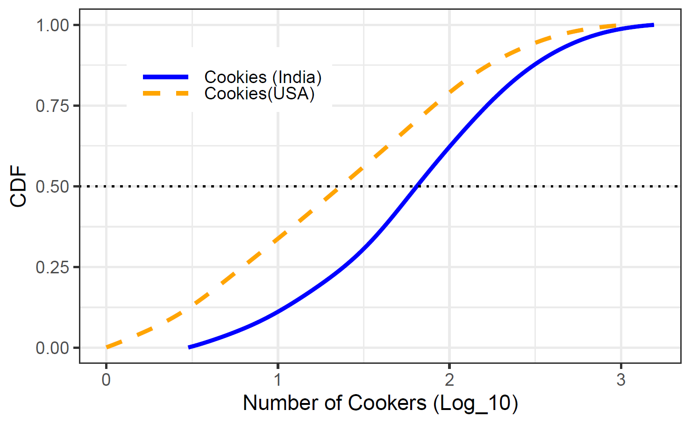
Results from case study 1
Cookies counts per website as an indicative of tracking
Median Tracking in India is “three” times then tracking in USA news.
Some websites can track by having 1000+ cookies
Agarwal et. al, ICWSM 2021

Slide 13
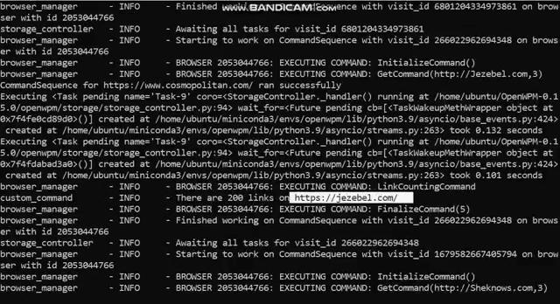
Case 2: Building user Personas
https://www.cosmopolitan.com/ ,
http://Jezebel.com ,
http://Sheknows.com
...

Slide 14
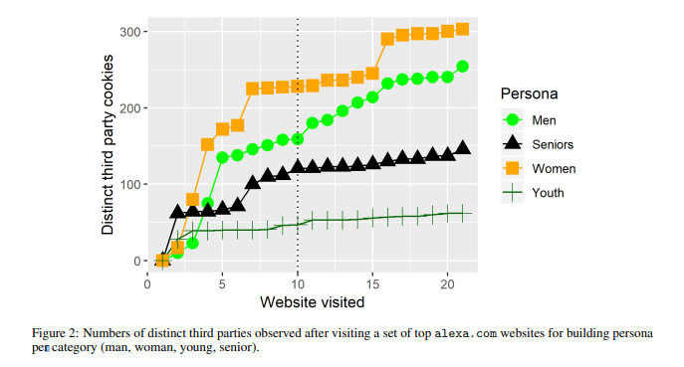
Results from case study 2
People have browsing behaviour.
Can exhibit certain characteristics:
Political affiliation
Demographics
Stateful Crawls with 20 websites
After visiting certain websites...
Exported as Profile.tar
Loaded on other crawls
Agarwal et. al, WWW 2020

Slide 15
What data should be collected?
Traffic logs
Cookies information
Javascripts
HTTPs logs
Meta: Visit sequence and settings
Profile.tar file (if stateful crawl)
Snapshots (if needed)
Agarwal et. al, WWW 2020

Slide 16
Hand On!
Analysis: So let’s try…
http://tiny.cc/openwpm-colab
OR https://colab.research.google.com/drive/17XxF4RPOkhpyJqvWGe2c0HBf10uZIIhE

